Slide 1
Br(AI)n Tumor Segmentation
Jack Etheredge, PhD

Slide 2
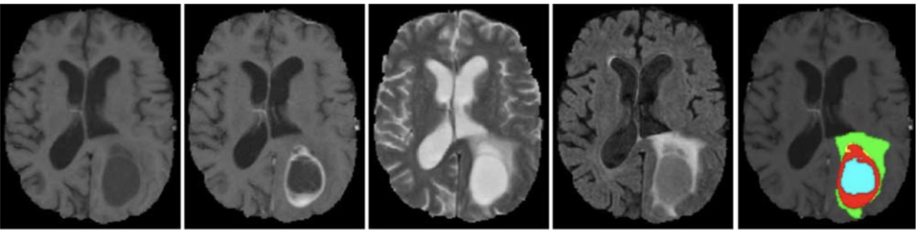
Glioma
Most common, most aggressive type of brain tumor
Surgery dramatically improves patient outcome
Extremely valuable to rapidly and accurately determine location of tumor to guide surgery
Notes:
Patient outcomes are dramatically improved by surgery and that surgery is guided by precisely determining the tumor borders beforehand.
Glioblastomas are the most common and most aggressive type of brain tumor that begins in the brain, thus any improvement in rapid and accurate classification is valuable.
It’s important to know the location and the location of the tumor in addition to the different parts of the tumor.
Location
Type
survival

Slide 3
Glioma – 3 tumor regions to determine
Edema
Tumor core
Necrotic tumor core
Notes:
> I’m going to show you a video of the 3D volume of images that I’m using as they truly exist.

Slide 4

MRI volumes:
Top
Front
Back
Ground truth annotation + flair contrast MRI
Notes:
We’re going through the brain left to right and you can see the different tumor region masks in 3 different colors.

Slide 5
Glioma – radiologist annotation
Radiologist annotation “ground truth”
Notes:
The standard workflow is for a radiologist to use different types of MRI contrast images and then make these annotations by hand.

Slide 6
4 types of MRI image per patient used as a 4-channel 3D volume
(4x240x240x155)
Notes:
I reproduced this workflow by treating the four different types of MRI image as 4 channels in a 3D volume, giving me a rather large 4x240x240x155 pixel volume.
Current models for achieving this use two separate models for the low-grade and high-grade glioblastomas, meaning that they only work when a radiologist has already gone through and classified them.

Slide 7
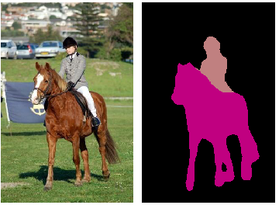
3D UNet Convolutional Neural Network (CNN)
Notes:
> I constructed a 3D u net CNN to solve this problem.
> The U-net takes in an image as input and produces a segmentation mask image as output with different masks for different types of object.
Segmentation task:
The first half is similar to a traditional CNN like you would use for classification, and then the deconvolution is used to generate output as an actual image
The concatenation between the convolution and deconvolution layers allows greater precision with respect to aligning the segmentation mask to the original images.
This is particularly important for medical imaging tasks, because pixel-wise differences can be very important.
http://www.mtechprojects.org/wp-content/uploads/2017/12/image-segmentation-projects.png
https://lmb.informatik.uni-freiburg.de/people/ronneber/u-net/

Slide 8
3D UNet Convolutional Neural Network (CNN)
Typical CNN first half
Summarization for classification
Notes:
> The first half of the Unet is effectively a traditional CNN like you would use for classification with successive rounds of summarization resulting in a classification output at the bottom
Segmentation task:
, and then the deconvolution is used to generate output as an actual image
The concatenation between the convolution and deconvolution layers allows greater precision with respect to aligning the segmentation mask to the original images.
This is particularly important for medical imaging tasks, because pixel-wise differences can be very important.
http://www.mtechprojects.org/wp-content/uploads/2017/12/image-segmentation-projects.png
https://lmb.informatik.uni-freiburg.de/people/ronneber/u-net/

Slide 9
3D UNet Convolutional Neural Network (CNN)
Second half:
Deconvolution creates an image
from pixel-wise predictions
Notes:
> The second half deconvolves this summary to generate an image of pixel-wise predictions for the different objects.
Segmentation task:
The first half is similar to a traditional CNN like you would use for classification, and then the deconvolution is used to generate output as an actual image
The concatenation between the convolution and deconvolution layers allows greater precision with respect to aligning the segmentation mask to the original images.
This is particularly important for medical imaging tasks, because pixel-wise differences can be very important.
http://www.mtechprojects.org/wp-content/uploads/2017/12/image-segmentation-projects.png
https://lmb.informatik.uni-freiburg.de/people/ronneber/u-net/

Slide 10
3D UNet Convolutional Neural Network (CNN)
concatenation for more accurate alignment
Notes:
> Concatenation between the convolution and deconvolution steps allows very precise alignment of of the mask to the original image, which is particularly important for medical imaging tasks
Segmentation task:
The first half is similar to a traditional CNN like you would use for classification, and then the deconvolution is used to generate output as an actual image
The concatenation between the convolution and deconvolution layers allows greater precision with respect to aligning the segmentation mask to the original images.
This is particularly important for medical imaging tasks, because pixel-wise differences can be very important.
http://www.mtechprojects.org/wp-content/uploads/2017/12/image-segmentation-projects.png
https://lmb.informatik.uni-freiburg.de/people/ronneber/u-net/

Slide 11
Ground truth vs prediction
Ground truth
Top
Prediction
Front
Back
Bottom
Notes:
These single image slices show the ground truth versus my 3D Unet’s prediction.
This is a random example from a holdout dataset and is not cherry-picked.
> I’m going to show two different types of videos that demonstrate the high correlation between the ground truth and my predictions through the 3D volume.

Slide 12
Segmentation predictions (3D slices):
Ground truth
Top
Prediction
Front
Back
Bottom
Notes:
Like the first video, we’re going through the brain left to right. Please note how correlated the ground truth and prediction are for all three tumor regions.
These are saggital sections, which means left to right, side on.

Slide 13
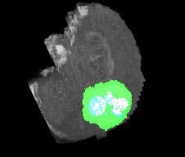
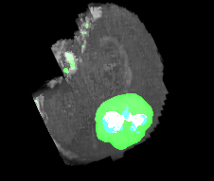
Segmentation predictions (3D rotations):
Ground truth
Top
Prediction
Front
Back
Bottom
Notes:
Now we can see in a 3D rotation the high degree of correlation in all 3 dimensions simultaneously.

Slide 14
Current state of the art:
Different models for different tumor subtypes
(requires prior physician annotation)
Dice score: % of correct pixels
88% for whole tumor
78% for necrotic tumor core
77% for tumor core
https://arxiv.org/pdf/1709.00382.pdf
https://arxiv.org/abs/1802.10508
Notes:
Current state of the art models use different models for different glioma subtypes.
This means that a radiologist must annotate beforehand for them to work correctly.
This is problematic for two reasons:
It typically takes 24 hours for turnaround from a radiologist to annotate the images if there is no backlog.
This means that it cannot be used as an automated pipeline.
State of the art performance is 88% of pixels are the the same between the ground truth and prediction for the whole tumor.

Slide 15
My 3D U-Net CNN:
Current state of the art:
Different models for different tumor subtypes
(requires prior physician annotation)
Dice score: % of correct pixels
88% for whole tumor
78% for necrotic tumor core
77% for tumor core
Treats the tumor subtypes together
(More realistic for an automated pipeline)
78% for whole tumor
67% average across the 3 classes
https://arxiv.org/pdf/1709.00382.pdf
https://arxiv.org/abs/1802.10508
Notes:
By contrast, my 3D U-Net takes in all of the tumor subtypes and thus can be used as part of an automated pipeline.
My 3D unet achieves a 78% pixel-wise accuracy.

Slide 16


Thank you!
Jack Etheredge, PhD
/jack-etheredge-phd
jack.etheredge@gmail.com
(Please hire me)
Notes:
Thank you. I’m Jack Etheredge. I look forward to talking with you afterward.

Slide 18
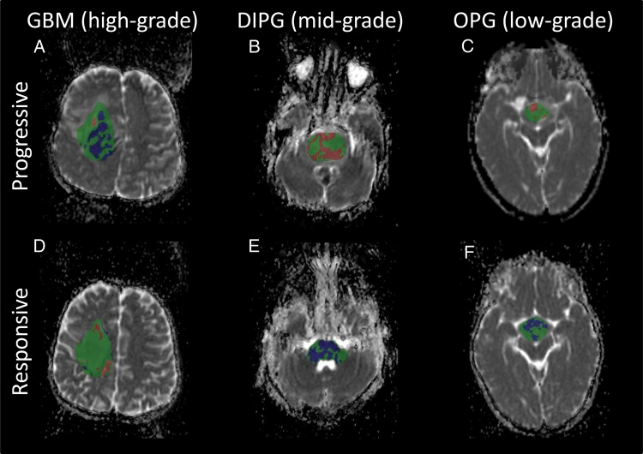
Segmenting high-grade and low-grade gliomas with the same model
Low grade glioma
Slower growing
Sometimes not malignant
High grade glioma (glioblastoma)
Faster growing
Malignant
https://www.ncbi.nlm.nih.gov/pubmed/24305721
Notes:
Current models for achieving this use two separate models for the low-grade and high-grade glioblastomas, meaning that they only work when a radiologist has already gone through and classified them.
Glioblastomas are the most common and most aggressive type of brain tumor that begins in the brain, thus any improvement in rapid and accurate classification is valuable.
*(Pare this down)
Location
Type
survival

Slide 19
Segmenting high-grade and low-grade gliomas with the same model
Low grade glioma
Slower growing
Sometimes not malignant
High grade glioma (glioblastoma)
Faster growing
Malignant
More diverse in shape due to tissue invasion
Sometimes lacking the “enhancing” tumor core
https://www.ncbi.nlm.nih.gov/pubmed/24305721
Notes:
Current models for achieving this use two separate models for the low-grade and high-grade glioblastomas, meaning that they only work when a radiologist has already gone through and classified them.
Glioblastomas are the most common and most aggressive type of brain tumor that begins in the brain, thus any improvement in rapid and accurate classification is valuable.
*(Pare this down)
Location
Type
survival

